Slide 1
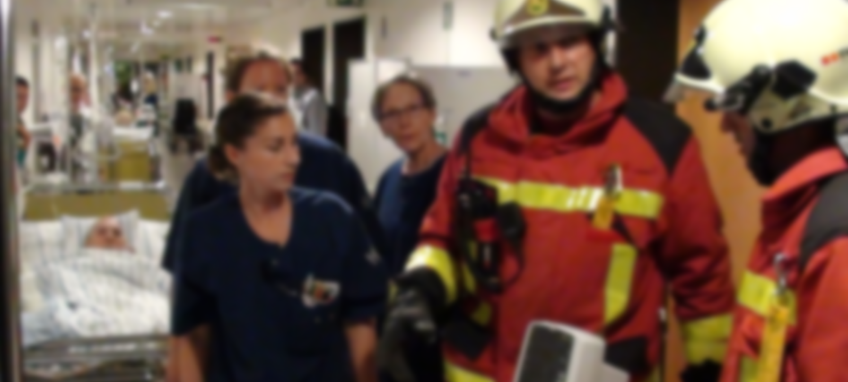

Smart Cities – critical infrastructure & resilience for citizens
(e.g. hospital)
IS-HSSE

Slide 2
Topics
IS-HSSE
Kantonsspital St.Gallen
facts & figures
Hospital challenges in
Smart City environment
Recommendations
& key focus areas
What happens if …

Slide 3
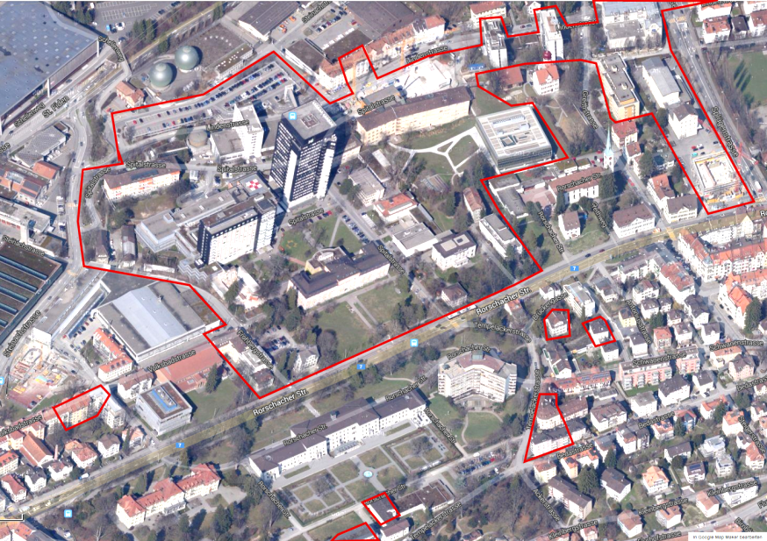
Kantonsspital St.Gallen – one entity, three hospital locations
(facts & figures)
5’400
Employees
87% Utilization of beds
35’000
Patients p. year
CHF 732 mln.
Net income
830
Care beds
7.7 d
Average stay
60 trucks/d
Incoming goods
4’500/d
Meals
1’600/d
Phone calls
6’746
Rooms to clean
Operations & Infrastructure
5’000 kg/d
Laundry
2’500/d
Postal items
120’000 m³/yr
Water
(= 600 private homes)
11.3 GWh/yr
Electricity
(= 2000 private homes)
Notes:
Kantonsspital St.Gallen (facts & figures) –
the public mandate / the mission
over 35
clinics / institutes / centers
Primary health care & medical care center for the canton of St. Gallen and neighbouring cantons
Interdisciplinary & inter-professional networking
Networking & cooperation
Research / training & continuing education

Slide 4


Hospital challenges – from the past to the future
Yesterday
Corporate Security
Organizational development
Definition
of tasks / responsibilities / authority
Process standardization
Use of
synergies
Centralization
Knowledge transfer
Tomorrow
Interaction & coordination

Slide 5
What happens if …
1. Secure ongoing operation
2. Capacity for additional tasks

Slide 6
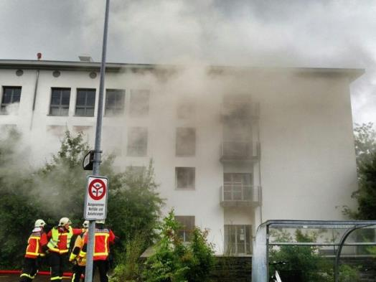
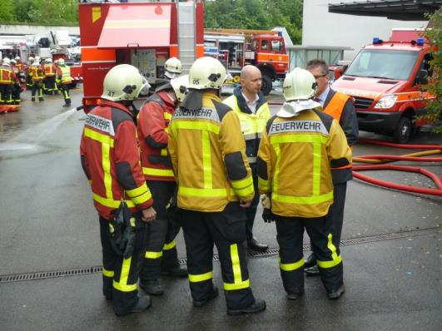
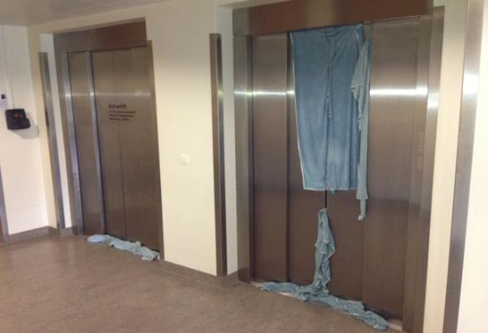
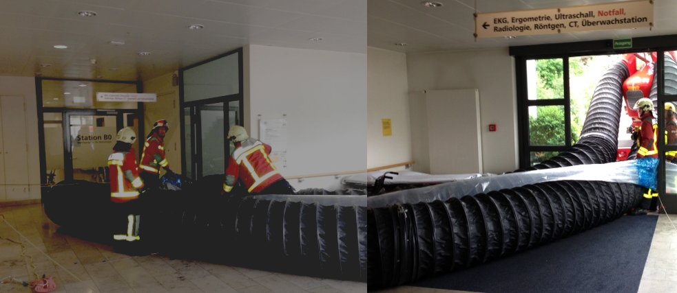
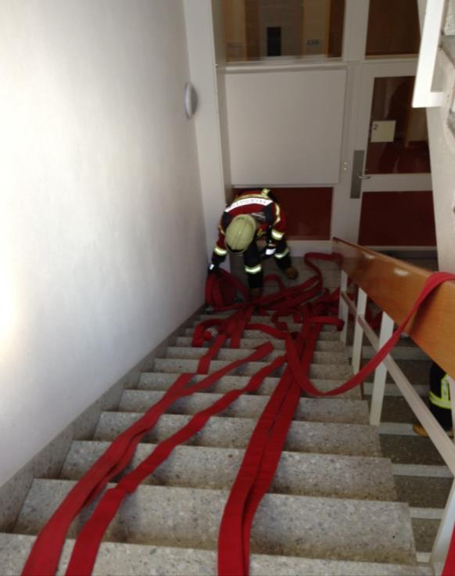
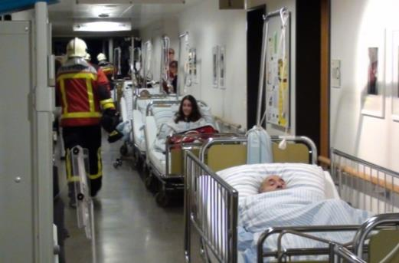
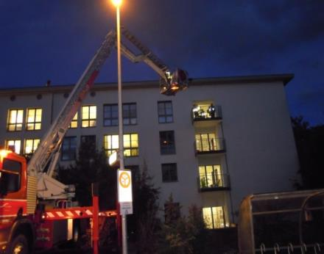

Slide 7
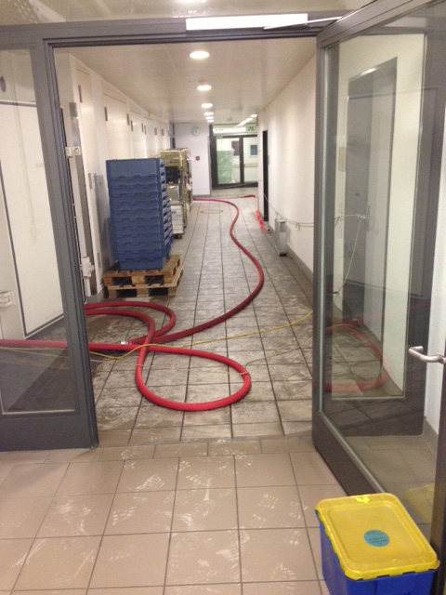
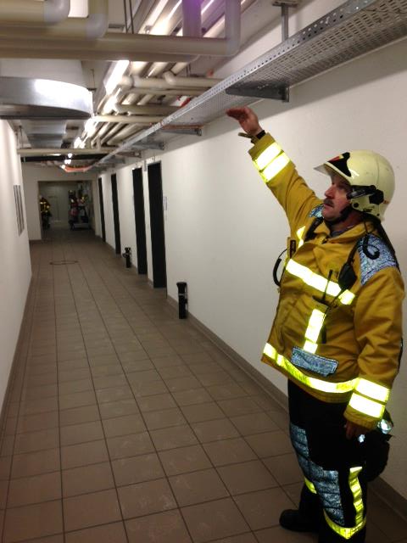
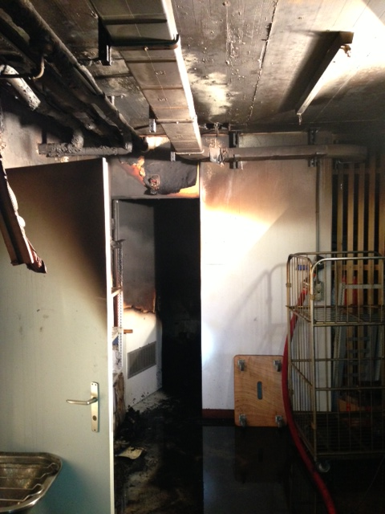
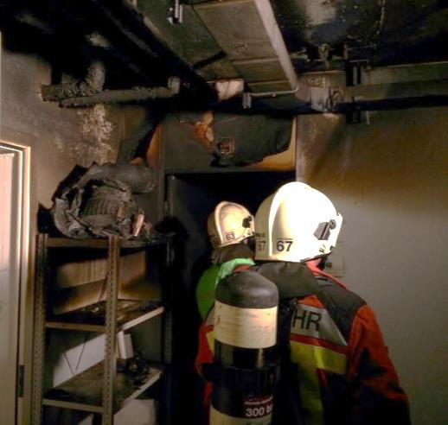
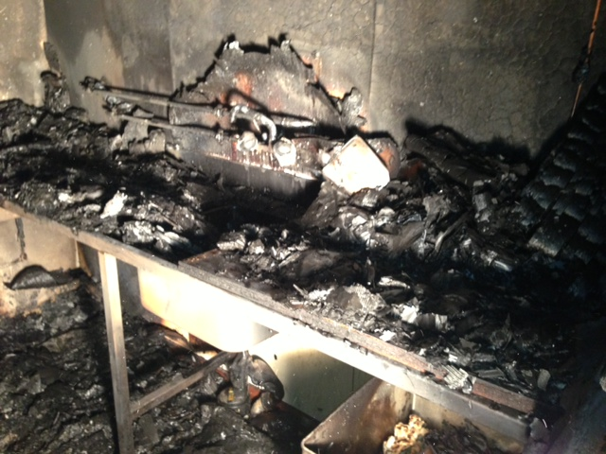
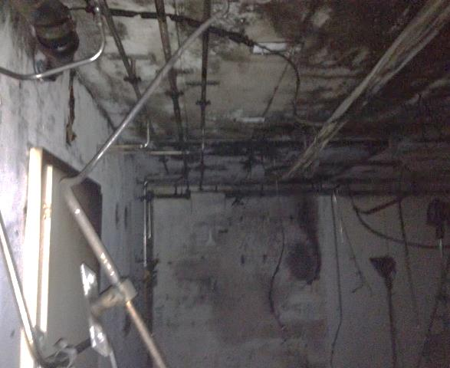

Slide 8
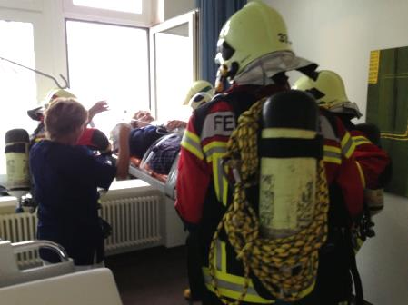







What happens if … – ressources & requirements / escalation & growth
Strategy
Protect:
prioritized activity
&
additional tasks
Respond:
continuity, reduction,
interaction,
damage handling
(incl. all resources)
Recover:
re-establish
normal operation
incident
emergency
crisis
disaster / catastrophe
manpower
Written plans for each phase
time
Adequate action / preparation
for each critical activity (probability / resilience / continuity)
Staff
Buildings / Infrastructure
Transportation / Logistics
Information / Data
ICT
Finance
Partners /
Subcontractors

Slide 9
Recommendations & key focus areas –
«Prepared for the future»
Facts & figures
Reality
Emotion
Awareness
Buy-in
Partnership
Show presence
Target
Keep going!
Walk the talk!
KISS: Keep it simple & safe!
SPOC: Single point of contact
AIOP: All in one package
GUI: Graphical user interface
ROI: Return on investment
SOP: Standard operating procedure
Follow the recommendation / alignment issue with an
opportunity of flexibility!

Slide 10
Thank you
for your attention!

