Slide 1
"Safe and Secure Solutions for Smarter Cities"
The value of standardization and certification in planning and managing Smart Cities

Slide 2
Cities today
A wide range of urban models but common challenges (budget, lodging, transport, population ageing ) and a lot of concern to face disasters consequence of climate changes
Major urban networks performances have achieved their limits
Third industrial revolution (ICT) : an opportunity to rethink urban networks and cities

Slide 3
The 21st century urban challenges
A challenge for humanity, an opportunity for new technical , economic and cultural solutions
A contribution to national growth and innovations
A source of competitiveness of smart and sustainable cities
To rethink resilient and adaptive cities

Slide 4
ISO 37101 – Management Systems
Background
  No International Standard on sustainable development and resilience
  A diversity of private documents based on different methodologies and assumptions
  A pressing need from Communities, their interested parties and users

Slide 5
ISO 37101 – Management Systems
Objective
  A Management System Requirements Standard reflecting consensus on an integrated, cross-sector approach drawing on existing standards and best practices
Benefits
  Guidance for communities when dealing with sustainability and resilience, in particular for those that may not have the means to develop their own schemes
  Possibility of benchmarking and exchange of best practices world wide
  Mobilisation of interested parties and users and emergence of innovative
  and cost-effective solutions
  Global improvement in sustainability and resilience of communities

Slide 6
ISO 37102 – Vocabulary
Background
  A wide range of terms with redundant or contradictory scopes and definitions
  A resulting confusion amongst stakeholders that is ineffective and counter-productive
  A pressing need for harmonization and clarification

Slide 7
ISO 37102 – Vocabulary
Objective
  To establish a common set of terms and definitions for standardization in sustainable development, resilience and smartness in communities, cities and territories
Benefits
  A common language for all interested parties and stakeholders at the national, regional and international levels
  Possibility of sorting out existing standards and reference documents in clear-cut categories
  Identification of gaps, where standardization is needed, as well as contradictions and redundancies in existing standards and reference documents
  Improved ability to conduct benchmarks and to share experiences and best practices

Slide 8
ISO 37120 & ISO TR 37121 – City Indicators
Background
  Different cities, different indicators
  Benchmarking difficult, if even possible
  Exchange of best practices limited

Slide 9
ISO 37120 & ISO TR 37121 – City Indicators
Objective
  A common set of indicators useable by every city in the world and covering
  most issues related to sustainability, resilience and quality of life in cities Benefits
Benefits
  Common basis for collecting data on cities
  User-friendly blueprint for less advanced cities
  More effective city governments and public services
  Better quality of life and of urban environment

Slide 10
ISO TR 37150 & ISO 37151 – smart infrastructure
Background
  Large number of different metrics to monitor smart urban infrastructures
  Trade limited due to lack of harmonisation
  Benchmarking difficult, if even possible

Slide 11
  ISO TR 37150 & ISO 37151 – smart infrastructure
Objective
  An international consensus on a harmonised metrics to evaluate the smartness
  of key urban infrastructure
Benefits
  Guidance for city governments on the level of performance they should expect
  from key urban infrastructures, e.g. when drafting specifications
  Guidance for city governments when organizing tenders and evaluating bids
  Illustration of where current infrastructures fail to perform and further research
  and development is required
  Emulation to progress towards higher level of technological excellence
  Stimulation of trade in smart urban infrastructure

Slide 12
CEN CENELEC ETSI smart and sustainable cities and communities coordination group (SSCC CG) proposals
To consider jointly smart and sustainable .
To consider smart and sustainability purposes as being defined in future ISO TC 37101.
Not to lead to rating or certification systems.
To consider communities instead of cities

Slide 13
SSCC CG ongoing works: a context-setting framework model for investigating gaps and needs in standardization
  A basic grid considering domains, infrastructures and players involved
    Y = The steps of a product or service
    X = the aspects of a product or service (market, operation, provision …)
  Different integration layers to be considered
  for optimazing interoperability/integration
    Organizational / strategy
    Informational
    Technical / data

Slide 14
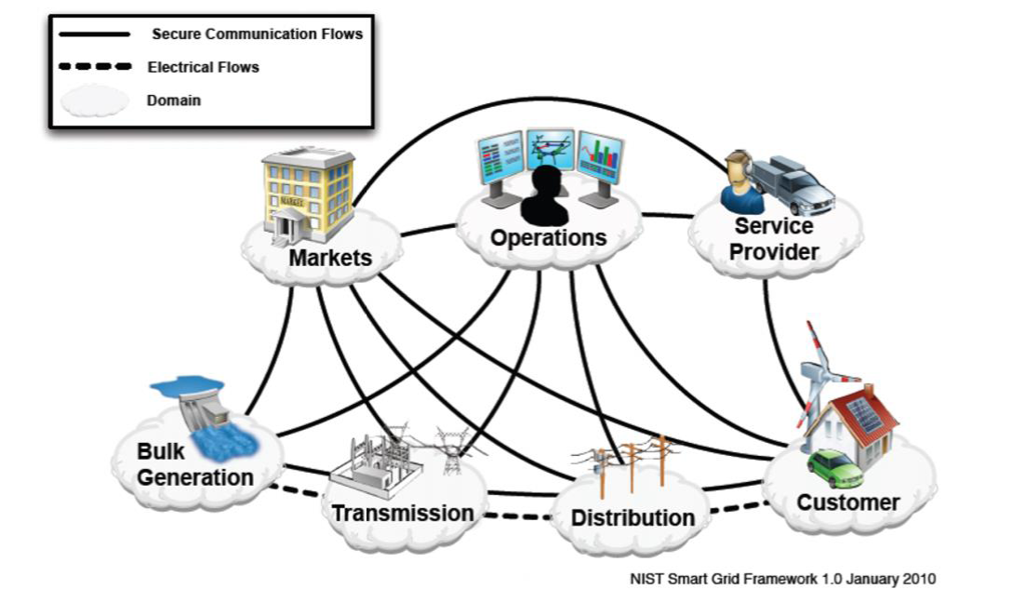

Slide 15
Different aspects to be considered in the context-setting framework model
Domains
Objectives
Systems
Infrastructures
Shareholders and interested parties
Scale

Slide 16
Interoperability – Integration
Interoperability has to be considered as a large concept of integration.
It cannot be limited to domain/domain exchanges.
It imposes common purposes to be considered in each domain

