Slide 1
“Secure and Safer Solutions for
Smarter Cities”
Nice - 12 May 2014 - Rolf Sigg

Slide 2
Background 1
According to the United Nations, more than 50% of the worlds population lived in cities in 2008.
By the year 2050 more than 70% of all people will live in cities
In the last decade Smartness has increasingly been seen as an answer to the megatrends which challenge cities, such as:
  Urbanization
  Population growth and ageing
  Population mobility
  Climate change
  Limited energy resources

Slide 3
Background 2
Cities are more than just the political and public administration with their institutions
The proper term would rather be “communities”
Cities in the sense of communities include all stakeholders:
  The citizens living in the city
  The businesses operating in the city
  The providers of critical infrastructure to the city
  The public administration managing the city
All stakeholders have distinct expectations towards the community they live or operate in

Slide 4
Background 3
Smartness of cities is currently essentially limited to energy-efficiency and ICT-based solutions for :
  Flows of People & Goods
  Flows of Energy
  Flows of Data
The European Innovation Partnership Smart Cities and Communities (EIP SCC), launched by the EC in 2012, only includes these three areas.
But: Only sustainable and resilient cities are truly competitive Smart Cities
Resilience is based on adequate safety and security management for the city

Slide 5
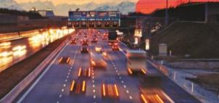

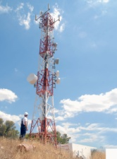
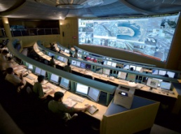
Euralarm Proposal
Citizens, businesses, urban processes and infrastructure rely on safety and security as key pillars to keep the Smart City functional at all times
A holistic Smart City dialogue therefore needs expertise and access to concrete solutions for safety, security, and resilience paired with related standardization & certification
Energy Grid
Management
Information,
Communication
Traffic
Management
Data Fusion
& Analysis
Smartness
Secure Smart City Processes, People & Infrastructure
Safety,
Security,
Resilience

