Slide 1

Fire Safety and Security in Hotels
The Industry’s viewpoint
Juan-les-Pins – 13 May 2014
Dominique Taudin

Slide 2

Why we need an EU-wide approach
Importance of the tourism sector in Europe
  Top holiday destination worldwide: 18% of global tourism segment⁽¹⁾
  4% of the EU GDP (6.5% in France)⁽²⁾
  20 million people work in the tourism sector not taking into account culture, food, fashion, construction and transport⁽³⁾
  Sector growth ~5% ⁽³⁾
  480M tourists visit Europe every year (France 77M, Spain 53M)
  Approx. 50% are non-EU residents
  200,000 hotels and tourist accommodations
  6,300,000 hotel rooms
  12,800,000 bed places
Speech by President Barroso at the 17th Tourism Summit – 2 Dec 2013
French Tourism Ministry – 2 Jul 2012
Eurostat

Slide 3
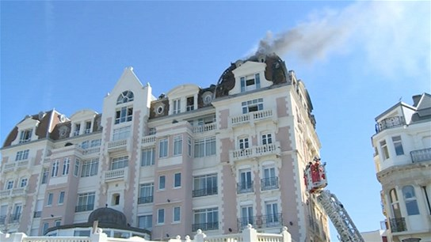
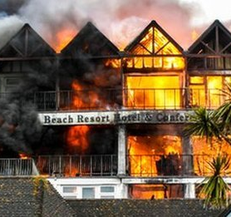
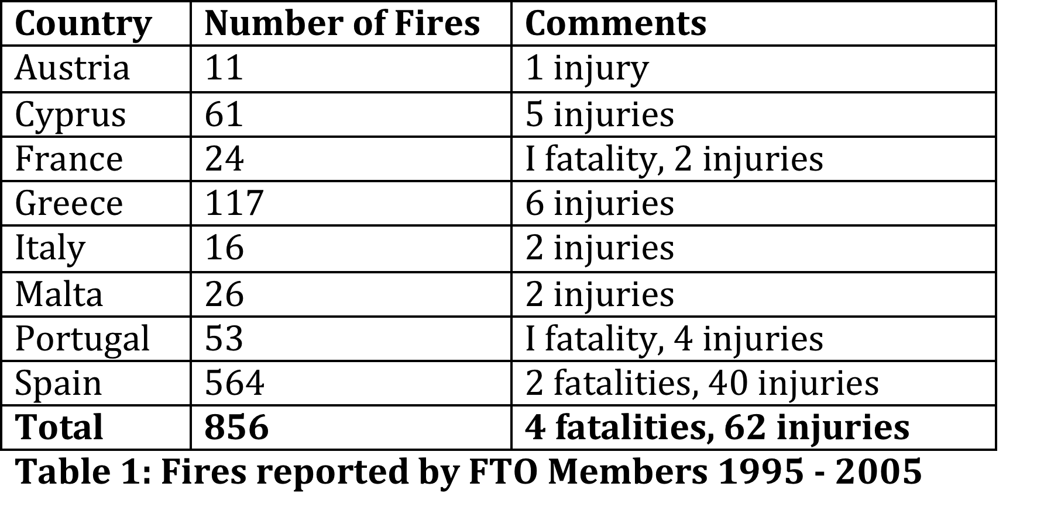
Why we need an EU-wide approach
Europe needs world-class tourist accommodations to keep its leadership in the sector
Europe is not immune
Saint-Jean de Luz/FR – 10 Mar 2014 (1 fatality)
Falmouth/UK – 30 Apr 2012

Slide 4
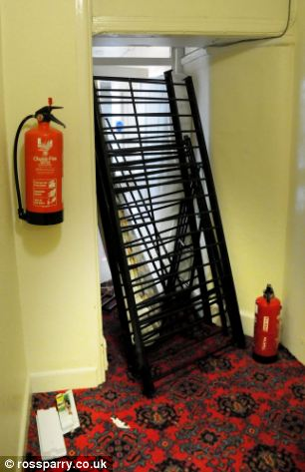
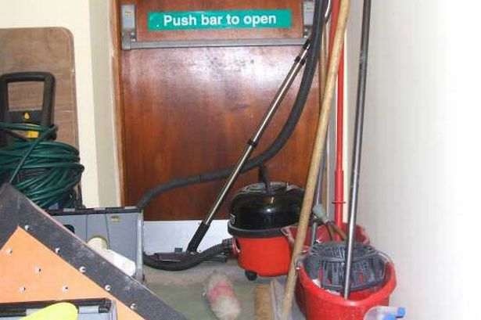
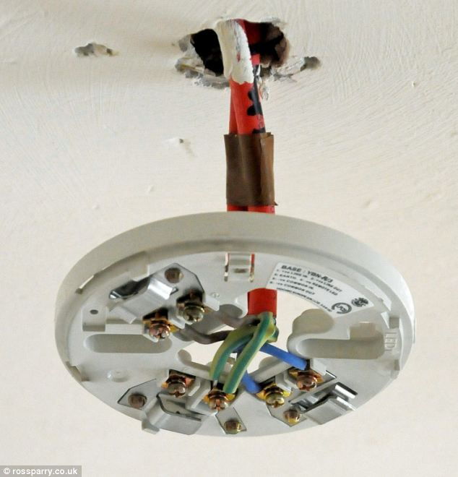
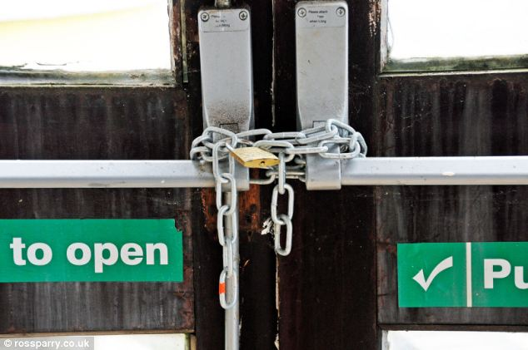
Why we need an EU-wide approach
World-class products and systems
Harmonized fire safety policies
Enforcement by local authorities
Fire safety management
Continuous risk assessment

Slide 5
Why we need an EU-wide approach
Each EU Member State produces its own fire safety regulations
Fire Safety and Security measures differ from a MS to another MS
  Fire detectors in corridor only vs. bedroom + corridor
  Building height and/or size thresholds for the mandatory installation of sprinklers / Water Mist
  Evacuation strategy esp. for mobility impaired people
  Etc…
Tourists visiting Europe legitimately expect a high and consistent level of protection, regardless of the height, size or type of "accommodation" they are staying in.
  International visitors see Europe as ONE country
  Lack of choice criteria re. safety and security – 50% hotel reservations via Internet
Unique opportunity to confirm Europe’s leadership in tourism by raising the bar and setting a higher level of safety for the next generation of hotels with a moderate impact on buildings cost

Slide 6
The Industry’s viewpoint
Legislation across EU member states is inconsistent, and the current non-binding Recommendation has not proven to be an efficient solution to this issue
MBS Methodology provides a pragmatic, result-oriented starting point, but has proven to be difficult to implement by the hotel industry alone, as it requires significant expertise in risk assessment
EURALARM calls for a legally binding EU-level instrument rather than a Recommendation
A Directive would be the most effective means of ensuring an adequate level of safety in all hotels across the EU

Slide 7
Directive on Hotel Safety & Security
A Directive should require Member States to implement national legislation on fire safety and security in hotels fulfilling minimum requirements established at EU level
Emphasis on:
  Product/system compliance to EN standards demonstrated by third-party EU-wide approval
  Qualified companies for installation, commissioning and maintenance complying with relevant European standards (if any, otherwise national standards/CoPs)
  Risk assessment is one of the possible approaches but some countries lack sufficient background – Requires third-party expertise

Slide 8
Directive on Hotel Safety & Security
Development of European standards (CEN/CENELEC) by all stakeholders (customers, tour operators, hotel industry, fire & security industry, authorities) underpinning the Directive
With such a framework instrument, member states would be able to consistently implement in their existing fire legislation additional safety measures for hotels as needed
Not adopting strong measures would constitute a missed opportunity to put an end to what in many cases are preventable deaths and injuries

Slide 9
EURALARM Conference
Safe and Secure Solutions for Smarter Cities
Fire Safety and Security in Hotels - The Industry’s viewpoint
Juan-les-Pins – 13 May 2014
Thank you!
Dominique Taudin
EURALARM Vice-President – Chairman Fire Section

