Slide 1

Consumer perspective on EU Hotel Fire Safety
Safe and Secure Solutions for Smarter Cities
Euralarm International Conference
Arnold Pindar, ANEC President
Raising standards for consumers
1
Notes:
1

Slide 2
Content
Consumer expectations
Background:
  Gaps in Recommendation 1986/666/EEC
  Debate on possible policy initiatives
Current situation
Conclusions and recommendations
Raising standards for consumers

Slide 3
Consumer expectations
Free movement of citizens in EU countries
Demographic ageing - larger proportion of future population will have a disability
Consumers expect to sleep safely in a hotel and to leave it safely & quickly if a fire occurs
Raising standards for consumers

Slide 4
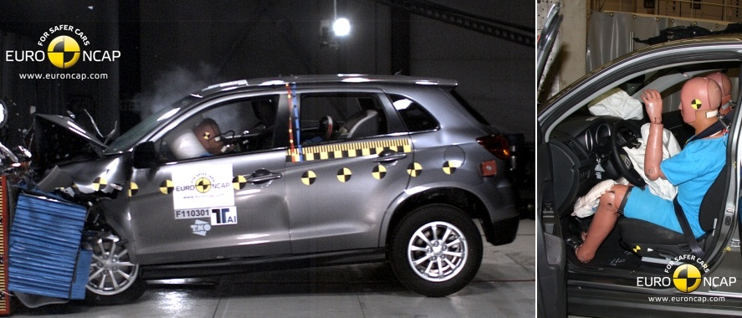
Consumer expectations
Do you know how safe is the hotel you book as you know the Euro NCAP rating of your car?
Raising standards for consumers

Slide 5
Are expectations met?
UK government data on fires in hotels, B&Bs, hostels:
2010/2011 1.200
2011/2012 1.000
2011, UK responsible authorities:
up to 51% inspected hotels poor in safety level offered
only 5-8% of hotels in UK inspected yearly
Raising standards for consumers

Slide 6

Reliable EU statistics?
National statistics unreliable to
determine true level of hotel fire
safety (diversity of methods, gaps)
Solutions?
- ANEC’s role in European coalition
calling on a Pan-European Accident
& Injury Data System
ISO TC 92 draft TR giving an overview of
national fire statistics practices…
Raising standards for consumers

Slide 7
Consumer safety
No EU legal framework for consumer services safety ≠product safety
ANEC’s call for EU legislative framework on safety of services underpinned by service-specific standards
Council Recommendation 86/666/EC (fire safety in Hotels) sole EU legislative tool in area of tourism services safety – long expected revision
Raising standards for consumers

Slide 8
The gaps of Recommendation
1986/666/EEC (1/2)
Aim: define minimum level of fire safety in hotels across EU …
Several studies* confirmed its ineffectiveness:
Inconsistent application (scope, occupancy)
Changed state-of-the art & applicable standards
Lack of understanding
  * -------------------------------------------------------------------------
2013 EP paper ‘Hotel Fire Safety – a case for legislation’
2008 EP IMCO Study by the EP on hotel safety
2001 EC Report on application of Rec. 86/666/EEC
2000&2009 FTO/ABTA Analysis on the implementation of Rec. 86/666/EEC
Raising standards for consumers

Slide 9
The gaps of Recommendation
1986/666/EEC (2/2)
Since 1986…
Lack of common minimum safety level in EU hotels
NO horizontal EU service safety legislation
→ ANEC calls for EU Directive supported by formal European Standards
Hotels diverse - not people’s needs: leisure, rest, sleep & eat
Raising standards for consumers
Notes:
European Standards (ENs) should be used to support the Directive or Regulation by defining the more technical specifications and requirements, through a process in which all interested parties can contribute. It should not be overlooked that the European Single Market for goods is founded on the similar principles of the New Approach and New Legislative Framework.
Hotels are diverse but people (in one sense, the need to rest, sleep and eat) are not
E.g. Toys are more diverse than hotels but we achieved a Toys Safety Directive which sets requirements that are met by European Standards
We can do the same for hotels of all types and sizes
Should Member States not find an agreement for the development of a Directive or Regulation on hotel fires safety in the short term, ANEC considers a revised Recommendation should be developed through the co-decision procedure.

Slide 10
Latest ‘developments’ 2009-2012
2009: DG SANCO asked the hotel industry (HOTREC) to develop Fire safety charter and methodology
2011: Management Buildings Systems Methodology published: consortium standard methodology, developed with limited consensus).
MBS open to wide interpretation:
“Carry out a risk assessment – your national hotel association can advise on how to do this”.
No independent monitoring or performance reporting; Lack of list of existing reference standards, guidelines
Raising standards for consumers

Slide 11
2012 Workshop on hotel fire safety
Revise Rec. 86/666 with HOTREC MBS Methodology?
HOTREC initiative valuable starting point
BUT
more binding approach to be adopted for laggers
MBS or any existing private specification should not be considered definitive within the context of a revised Recommendation or other legal instrument
Need more comprehensive analysis & direct consideration by all stakeholder experts
Raising standards for consumers

Slide 12

2012 …to today
DG SANCO & DG ENTR announce wider approach in future EC Green Paper (?) on the safety of consumer services…
ANEC welcomed DG SANCO initial will for sector specific & holistic approach
Timing is still unknown
Raising standards for consumers

Slide 13

Moving beyond Rec. 86/666/EEC
If no consensus on a directive, revision of Rec 86/666 through co-decision, with improvements:
Flexibility (applicable to all hotels, new old & smaller)
More focus on:
fire safety management, emergency planning & staff training
Needs of persons with disabilities
Raising standards for consumers

Slide 14
What is needed for effective hotel fire safety?
Planning & Enforcement!!
Good standards of fire safety to underpin law and show compliance consinstently
Effective active & passive fire safety
Decisions on equipment installation must be based on a Fire Risk Assessment of individual hotel (maintenance (?!), false safety messages)
Safety designed in service provided
Raising standards for consumers

Slide 15
ANEC Conclusions & Recommendations
Consumers expect hotels to be “fire safe” regardless of the location of the hotel, its age or size.
EU Institutions to admit limits of voluntary instruments in ensuring minimum level of fire safety in hotels thru EU
recommend a formal legislative solution underpinned by European Standards – a proven success in other business sectors!
Need for EU collation of statistics on fires in tourist accommodation & for records to be kept by hotels
Raising standards for consumers

Slide 16

Thank you for your attention!
Any queries?
Arnold Pindar
President@anec.eu
www.anec.eu
Raising standards for consumers

