Slide 1


NL-Alert
May 2014
Paul Kubben
Policy Advisor
Ministry of Security and Justice

Slide 2


Index
NL-Alert: where we stand
Lessons learned
Work in progress

Slide 3
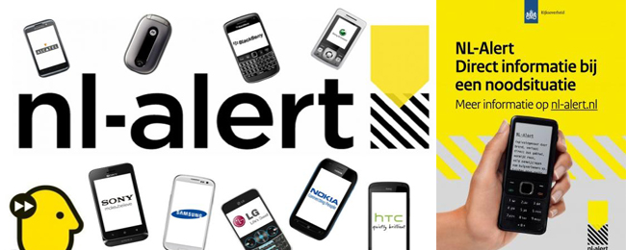
What is NL-Alert?
  Text message on mobile phones
  to alert people in close
  vicinity of an emergency situation
  Supplemental alert system for emergency situations → one of a mix of crisis communication tools
  Nationwide launch on 8 November 2012
  Alarms a specific area, applicable in different types of emergencies, high density of mobile phones in NL
  Cell broadcast, not sms (radiosignal, 1 way traffic)

Slide 4
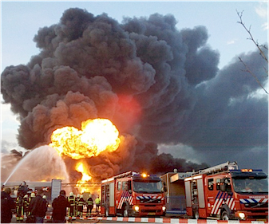
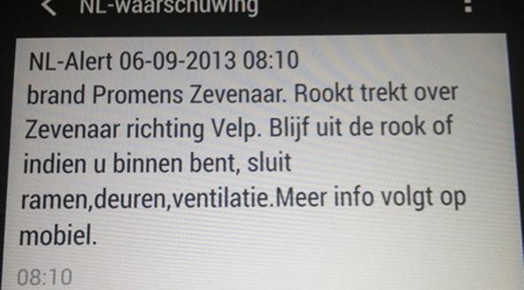
NL-Alert

Slide 5






NL-Alert Architecture
Direct influence of Ministry of Security and Justice
Safety region
Alarms
Broker
Divides
Providers
Sends
Handset vendors
. make handsets suitable
. sell handsets
Citizen
. choose and buy handsets
. receive NL-Alerts
. act accordingly
PSAP
Samsung
2G
KPN
Apple (iPhone)
PSAP
3G
Blackberry
PSAP
Centric
2G
HTC
T-Mobile
PSAP
3G
Microsoft (Windowsphone)
PSAP
2G
LG
Vodafone
3G
Sony
Nokia

Slide 6
NL-Alert: where we stand
Relevant statistics: 16.9 million citizens, 15.5 million citizens with at least 1 mobile phone, 22 million sim cards
NL-Alert available in all 25 Safety Regions
Actual usage since November 2012: 30 times (mostly large fires, but also in case of a small twister and a bomb detonation)
Actual usage of sirenes: 1 or 2 times per year
Two nationwide verification messages in 2013

Slide 7
NL-Alert: Nationwide verification messages
Main goal of verification message: awareness of NL-Alert in general and awareness of mobile phone settings
Results in February 2013: 1.4 million reached citizens (9%)
Results in November 2013:
- 3.9 million reached citizens (25%)
- 86% says that they will circulate the NL-Alert message
- 84% thinks it is a good idea to alert people via mobile phones in case of an emergency situation
NL-Alert is a growth model: network + device

Slide 8

Nationwide public awareness campaign NL-Alert around February 4 and November 4
Advertising spots on national and regional television and radio, banners on websites, social media
Main goal: provide general information about NL-Alert and expand number of programmed phones

Slide 9
Lessons learned
Actual usage is going through a learning curve (regarding area selection, but also clear content of messages)
Paradox: at the starting point of a learning curve a low media profile is desirable; to expand the number of programmed phones and create awareness a high media profile is necessary
Needs of actual users are part of the learning curve
Communication is very important, beware of portrail on different levels (government and ICT in general, but also biased influencers of the public debate)
Supporting laws or regulations are eligible

Slide 10
Work in progress
4G in 2014/2015
Direction on the national level to providers, based on existing laws
User consultation
Research into broadening the system (weather information)
Research into ‘the American way’: obligation of the handset vendors to make customers aware of the suitability of a mobile phone for NL-Alert
Nationwide framework for the actual usage of NL-Alert (in stead of a regional framework)
Cooperation and standardization on a European level (working group cell broadcast)

Slide 11
Inhoud presentatie
?

