Slide 1
Change of the
Euralarm Statutes
GA 2014 / Juan les Pins
Derek Harrington
Chairman TC Finance

Slide 2
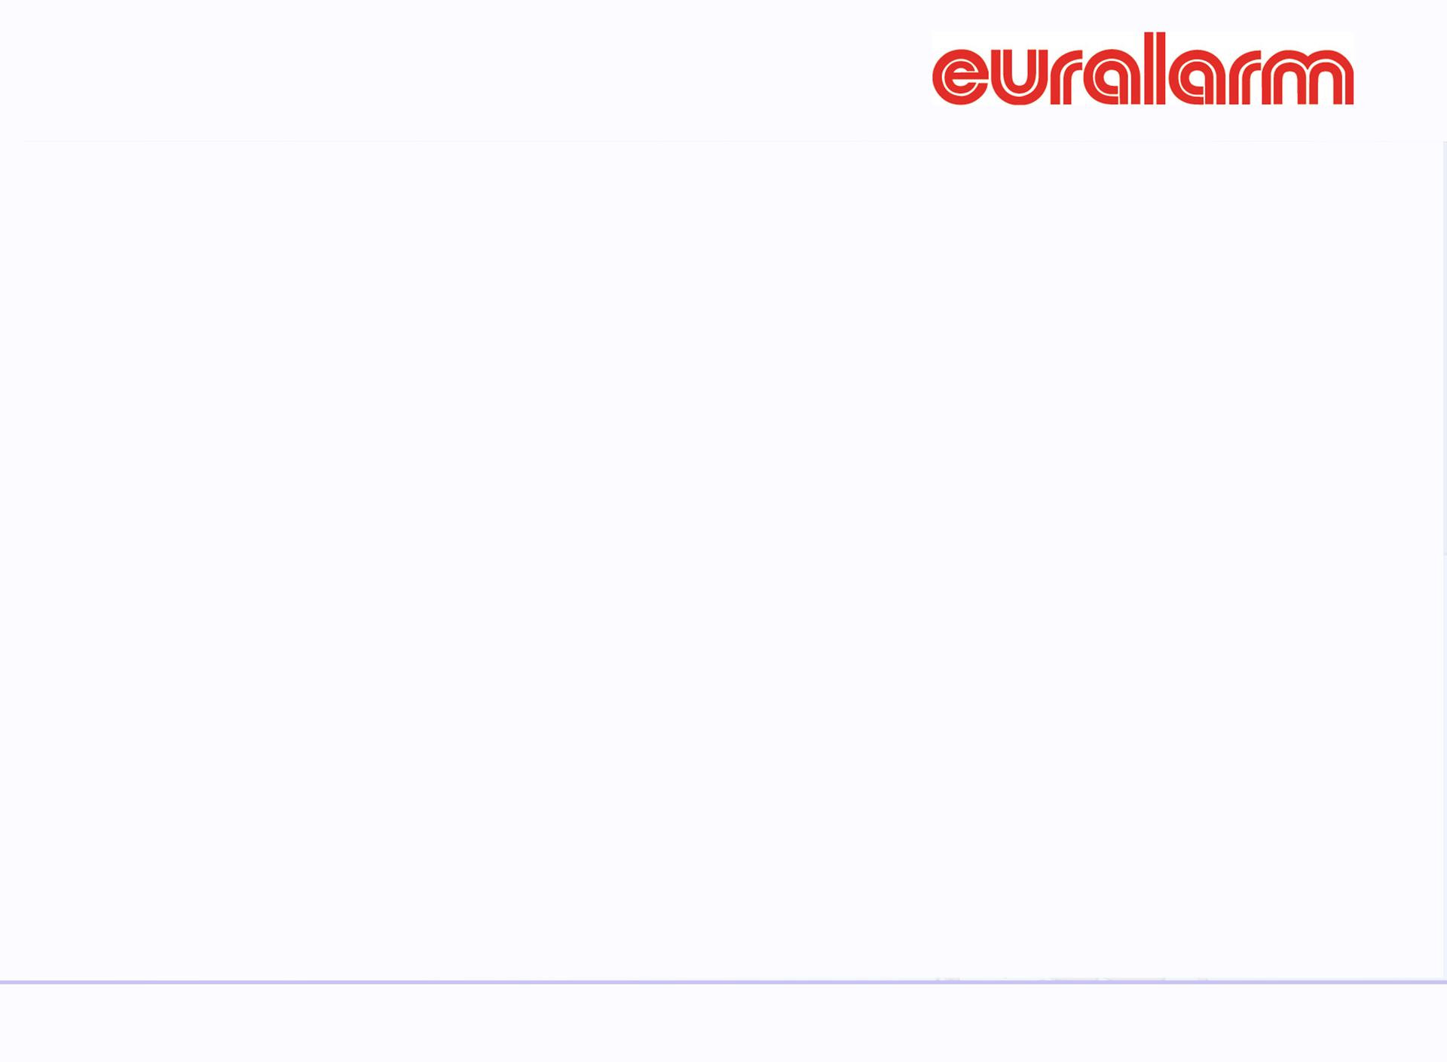
Motion 1: Membership – Art.2
To ease the acquisition of new members:
  from areas not covered by existing association members of Euralarm
  from countries without association members
  From research, education, science institutions active in areas relevant for Euralarm
To give Euralarm the ability to grow and better represent the industry in the future.

Slide 3
New Art 2.1.
Article 2.1 Acquisition
Membership in accordance with Art. 1.2 may be applied for
1. by trade associations(TA) registered in the geography of Europe;
or
2. by individual companies registered in the geography of Europe and member of at least one Trade Association already member of EURALARM.
or
3. by individual companies registered in the geography of Europe from a country where no relevant trade association exists already member of Euralarm.
or
Institutes or associations registered in the geography of Europe being active in research, education and science in fields as specified in Art. 1.2
fulfilling the following criteria:
  pays membership-fee and provides people for the EURALARM organisation
  perspective for a longterm relationship
Applications for membership in one of the sections shall be submitted in writing to the General Secretary. Admission to membership shall be decided upon by the EURALARM Board. All these decisions shall be taken in accordance with Art. 4.3 paragraph 5/6 of these Statutes.

Slide 4
Motion 2:
Because of the change from Section Committee meetings to Section members meetings it has become more difficult to find candidates not beeing a member of the Section members meeting who are active, knowledgable and willing to act as an Auditor.
The new proposal:
  Candidates shall not be member of the Board
  Every section can nominate and elect an Auditor
  There should be at least two different persons as Auditors elected by the three sections

Slide 5
New Art 9
Article 9 The Auditors
  Accounting shall be subject to control by a minimum of two Auditors. The Auditors (who are not members of the EURALARM Board) shall come from the membership, elected by the Members meeting of the sections for a term of three years. They shall check annually the book-keeping and the finance management of EURALARM by the sampling method.
  They shall give a report on their findings to the General Assembly.

Slide 6
Old Art 2.1
Article 2.1 Acquisition
Membership in accordance with Art. 1.2 may be applied for
1. by trade associations(TA) registered in the geography of Europe;
or
2. by individual companies registered in the geography of Europe and member of at least one Trade Association already member of EURALARM.
or
3. by individual companies registered in the geography of Europe from a country where no Euralarm trade association member exists.
fulfilling the following criteria:
  pays membership-fee and provides people for the EURALARM organisation
  perspective for a longterm relationship
Applications for membership in one of the sections shall be submitted in writing to the General Secretary. Admission to membership shall be decided upon by the EURALARM Board. All these decisions shall be taken in accordance with Art. 4.3 paragraph 5/6 of these Statutes.

Slide 7
Old Art 9
Article 9 The Auditors
Accounting shall be subject to control by three Auditors. The Auditors (who are not members of the EURALARM Board or either Section Members Meeting) shall come from different sections, elected by its Members meeting for a term of three years. They shall check annually the book-keeping and the finance management of EURALARM by the sampling method.
They shall give a report on their findings to the General Assembly.

